Slide 1
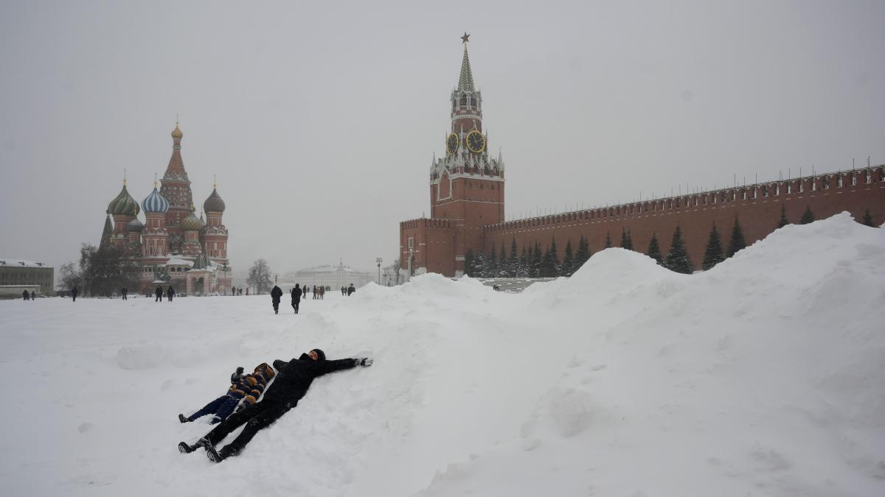
Prisoners of Geography.
Russia, trapped in the ice.

Slide 2
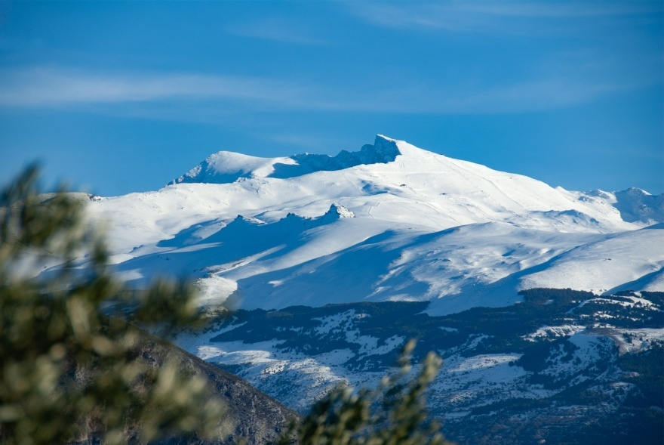
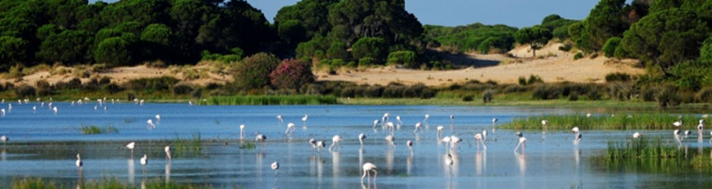
Vocabulary:
The variations in the elevation of the earth's crust are called relief. Relief is constantly changing. However, these changes take place over long periods of time, which is why we do not notice them.
Mountains are natural elevations of the terrain, when joined together they form mountain ranges.
Plains are flat, low-lying tracts of land.
Plateaus are highplains.
Depresions are very low areas that may even be below sea level.
Continent is an area of land forming part of the earth's crust that rises above sea level. They make up thirty four % of the Earth's total land area.
Ocean is the sea of immense dimensions that covers most of the earth's surface (according to experts, seventy one %).

Slide 3
CLIMATE | Location | Temperatures | Precipitation | Landscape
Equatorial | Near the Equator | Average anual temperatures are around twenty five degrees centigrade, with little variation in anual temperature. | Total annual rainfall is higher than two thousand millimetres. It rains every month. | Jungle
Tropical | Between ten degrees and thirty degrees north and ten degrees and thirty degrees south | Average anual temperature is over twenty degrees centigrade. There are variations of between three and ten degrees centrigrade. | The total anual rainfall ranges betweentwo thousand millimetres and and less than four hundred millimetres. Seasons alternate between dry and wet. | Tropical rainforest and Savannah
Desert | Found at the same latitudes as tropical climates | Average temperatures are high, over twenty degrees centigrade. There are big differences between day and night. | Scarce, less than two hundred and fifty millimetres , and irregularly distributed. | Desert
Mediterranean | Between latitudes thirty to forty degrees in both hemispheres | Average anual temperature between ten and eighteen degrees centigrades. Temperature variations of between twelve and sixteen degrees. Summers are hot and winters mild. | Ranges between nine and three hundred milimetres a year. Distribution is irregular and summers are very dry. | Mediterranean woodland and bushes.

Slide 4
CLIMATE | Location | Temperatures | Precipitation | Landscape
Oceanic | Between latitude forty and fifty , and even sixty, in both hemispheres. | Average anual temperature between ten and fifteen degrees centigrade . Little temperature variations. Winters are mild and summers are cool. | Annual total is around one thousand millimetres. It is regular throughout the year. | Deciduous forest and moors.
Continental | Inland, in North America, Europe and Asia. | Average anual temperature between zero and ten degrees centigrade. Very high temperatura variations. Winters are long and cold, and summers are short and hot. | Ranges between seven hundred and fifty and three hundred milimetres. It is irregular, with the highest precipitation in summer. | Taiga or conifer forests. Prairies and steppes.
Polar | Near the poles. | Average temperaturas are below zero. It is never higher than ten degrees centigrade. | Scarce, lees than two hundred and fifty millimetres annually. It mainly falls as snow. | Tundra ( an area of mosses and lichens).
Mountain | High mountainous areas. | Temperatures decrease with altitude. Summers are short and cool. Winters are long and very cold. | Ranges nine hundred and three hundred millimetres per year. Distribution is irregular and summers are very dry. | Vegetation varies according to altitude.

Slide 5
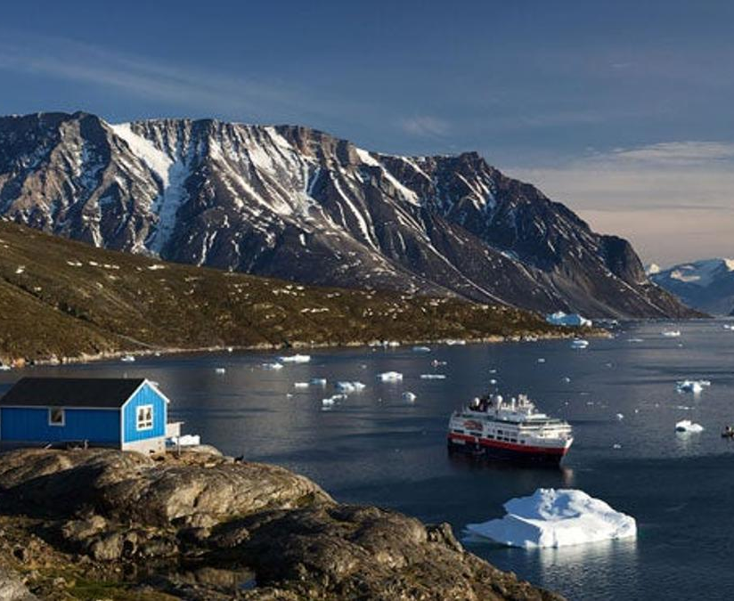
Environmental effects of air pollution
Smog and acid rain
Hole in the ozone layer
GREENHOUSE EFFECT
It is formed by a chemical reaction between sunlight and nitrogean oxides at ground level. It is common in big cities.
It occurs when nitrogen oxides and carbon dioxide mix with rain to prodice acids. It attacks and destroys plants. It also increases the acidity of rivers and lakes, which affects their wildlife and vegetation.
Ozone is a gas found in the atmosphere that absorbs ninety percent of the ultravioletradiation from the Sun.
The ozone layer becomes thinner in the polar regions causing the poles to melt.
Some gases are known as greenhouse gases.
Some human activities produce greenhouse gases, such as industrial activity or transport.
The consequences are very serious: the polar ice caps are melting faster than ever, climate change or some ecosystems are being destroyed.

Slide 6
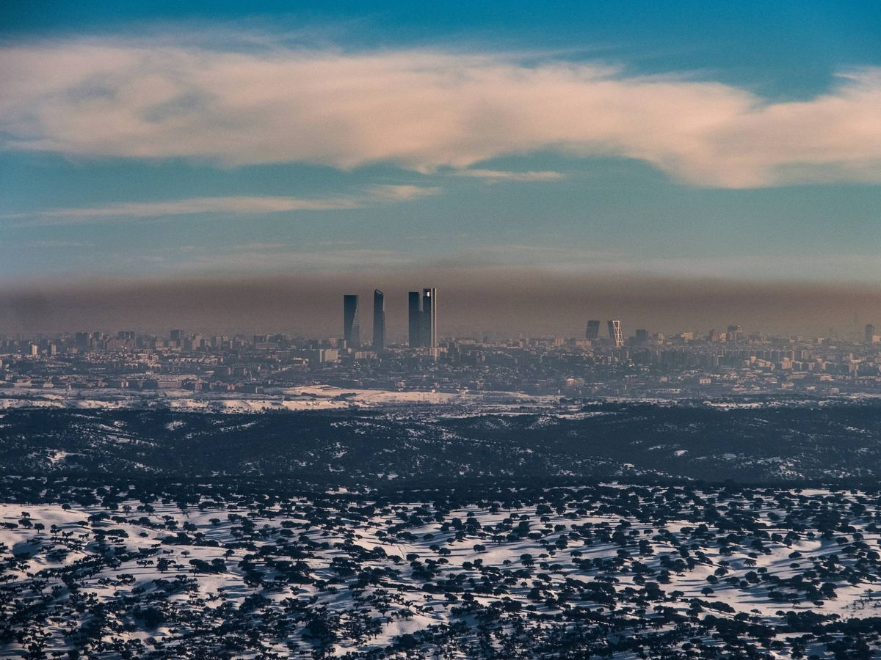
It is common in Madrid winters because of emissions from cars and heating systems.

Slide 7
Protected natural areas in Spain
National Park
Natural parks
Other natural Areas
A national park is an area of natural and cultural importante with no urban centres. It has flora, fauna geological features of special interest.
The objectives are to ensure the conservation of these unique áreas, to balance conservation with public access and encourage scientific research
Natural Parks are areas that are managed by autonomous communities.
Human activity is permitted in these areas but residencial use is restricted.
Nature reserves are areas dedicated to protecting biodiversity, geographic and geological features and fragile ecosystems.
Natural monuments are spaces that protect a valuable natural feature, such as rock formations, underwater caves or ancient forests.

Slide 8
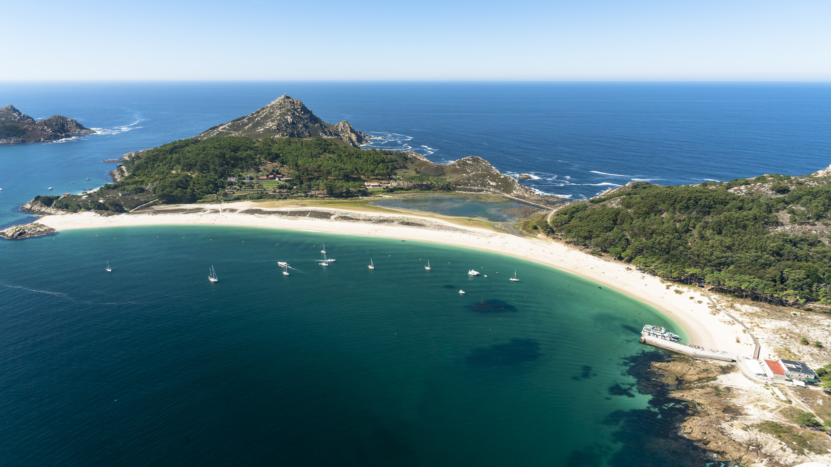

Slide 9
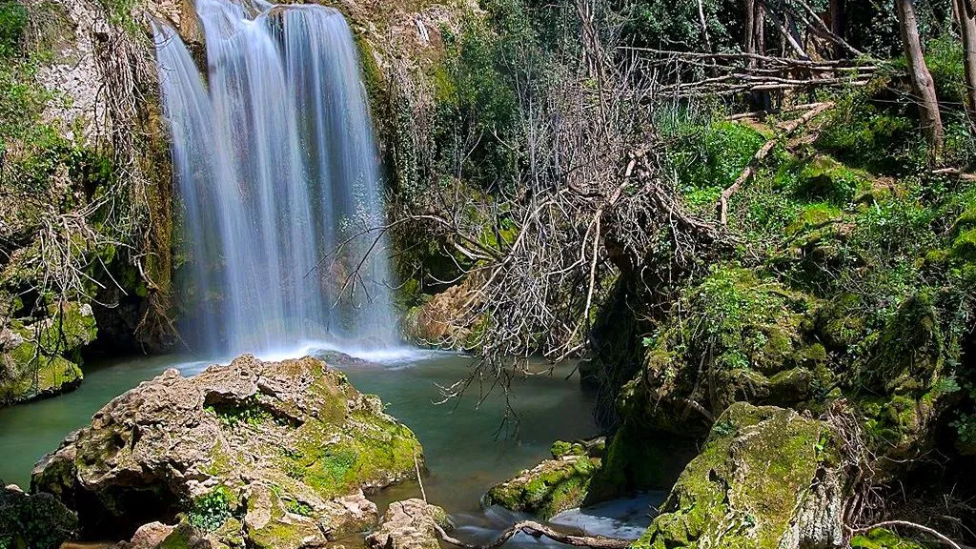

Slide 10
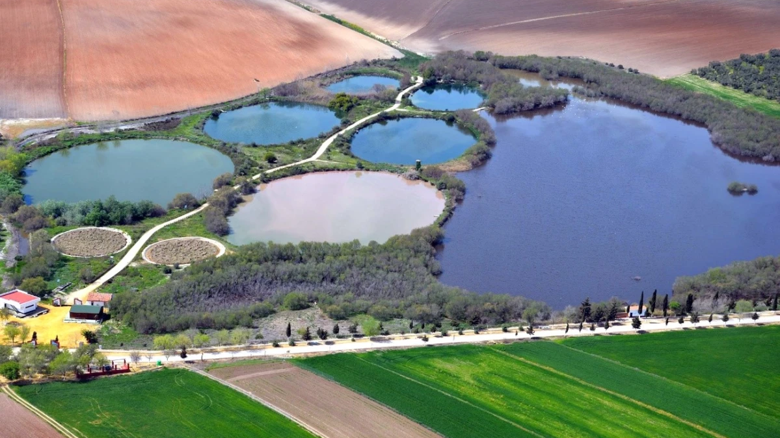

Slide 11
