Slide 1
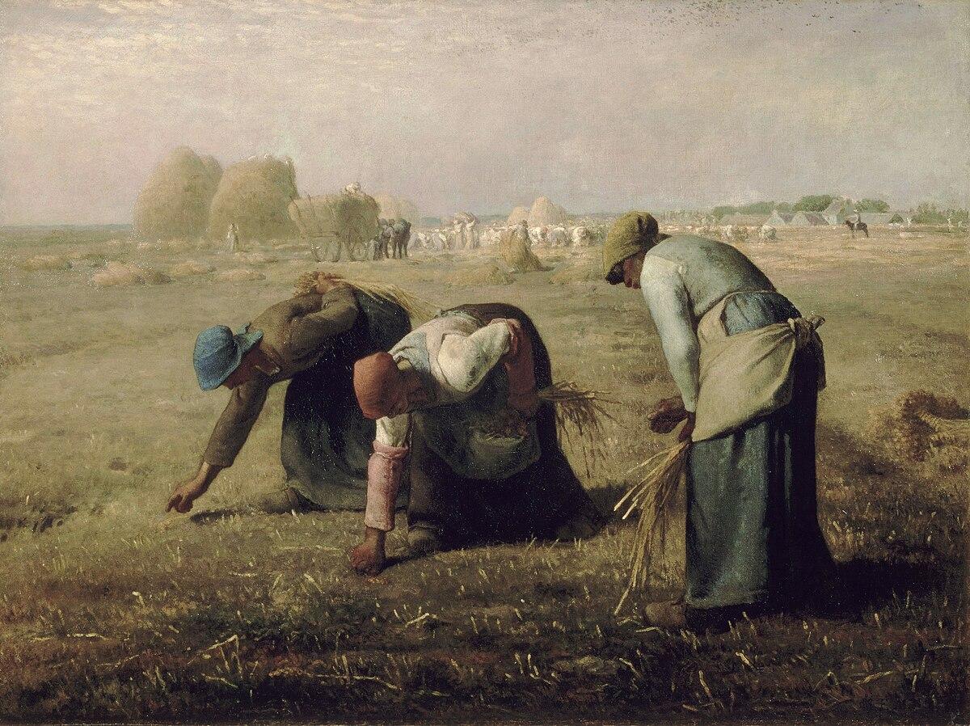
FROM THE ANCIEN RÉGIME TO THE CONTEMPORARY AGE.
THE FRENCH REVOLUTION

Slide 2

Characteristics of the Ancien Régime
The economy of the Ancien Régime was mainly rural. Agriculture used tradicional methods with few technical innovations, and productivity was low. Most people practised subsistence farming, and trade was rare.
Although agriculture was predominant activity, the bourgeoisie developed artisan and manufacturing activities.
Society was divided by traditional law into three estates: the clergy, the nobility and ordinary people or the Thrid Estate (peasants, the urban working classes and the bourgeosie).
The predominant form of government in Europe was absolute monarchy by divine right. The King´s authority came from God and he exercised power in God´s name.

Slide 3
The Enlightment
The Enlightenment was an intellectual movement that developed in Europe during the 18th century. It criticised the Ancien Régime and questioned its system of power and beliefs.
The Enlightenment wanted to understand the world through reason. It was a direct critique of the religious basis of most Western societies, where the Church exercised powerful social control.
According to Enlightenment thinking, the way to knowledge and the basis of happiness was education.

Slide 4
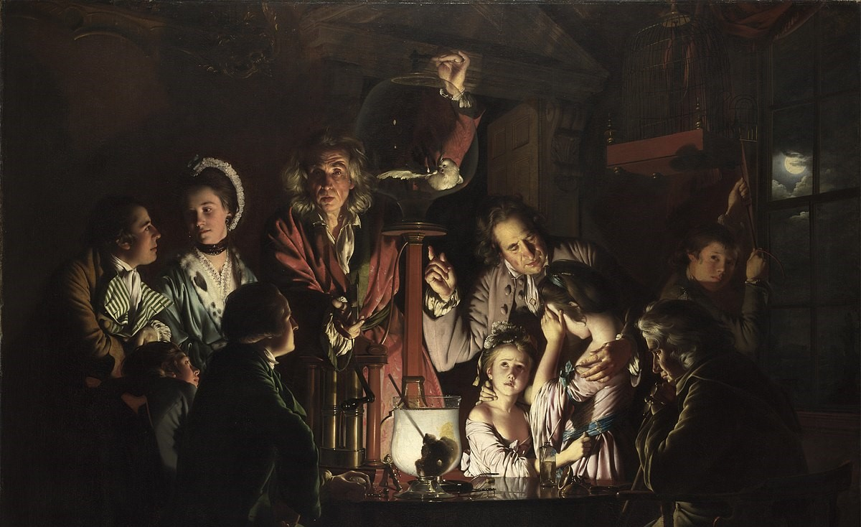
Joseph Wright “An Experiment on a Bird in the Air Pump”

Slide 5
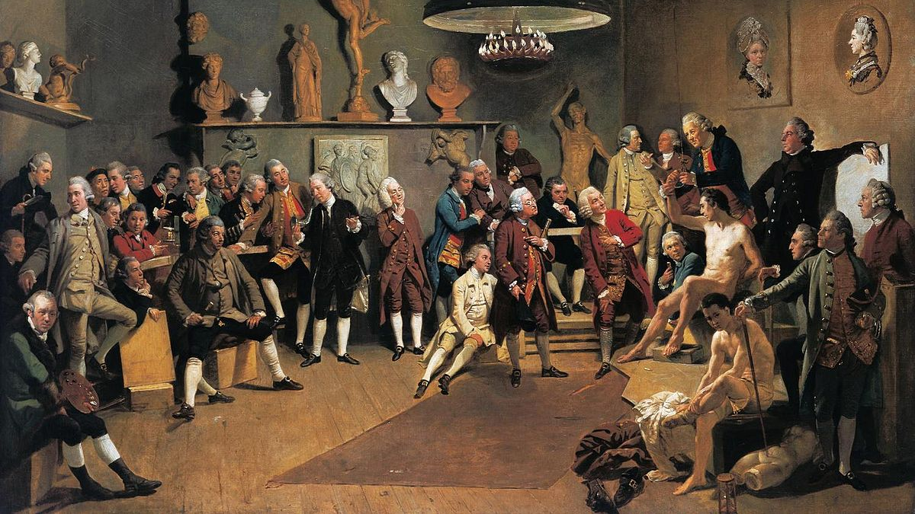
Academies were areas for the study of science and the arts in the 18th century, with exclusive access for men.

Slide 6
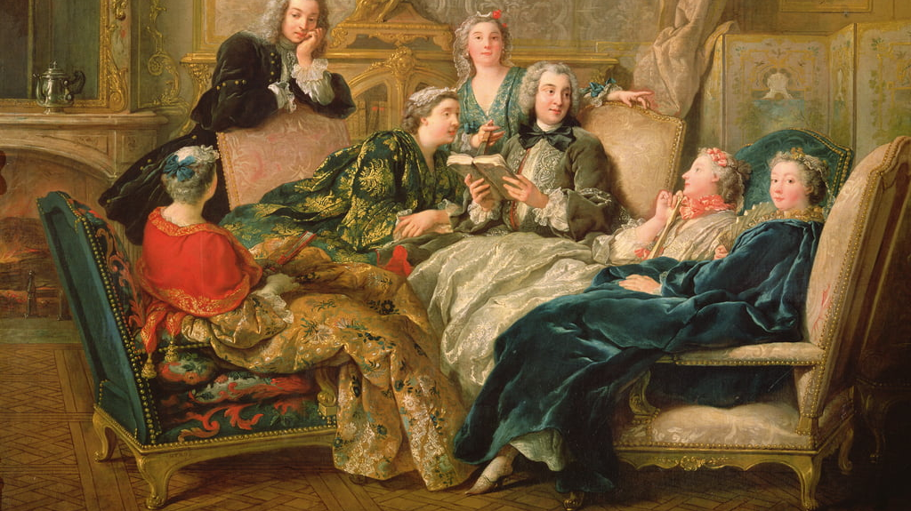
The transformation of reading habits was fundamental to the spread of knowledge in the Enlightenment.

Slide 7
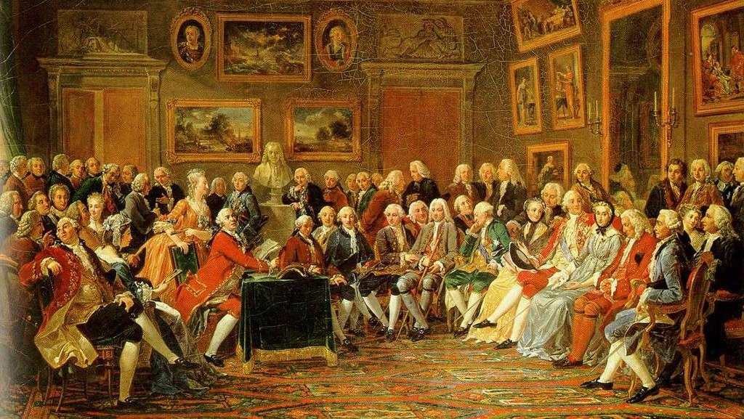
The salons of some noblewomen became spaces of free debate during the Enlightenment. Madame Geofrin's salon is an example.

Slide 8
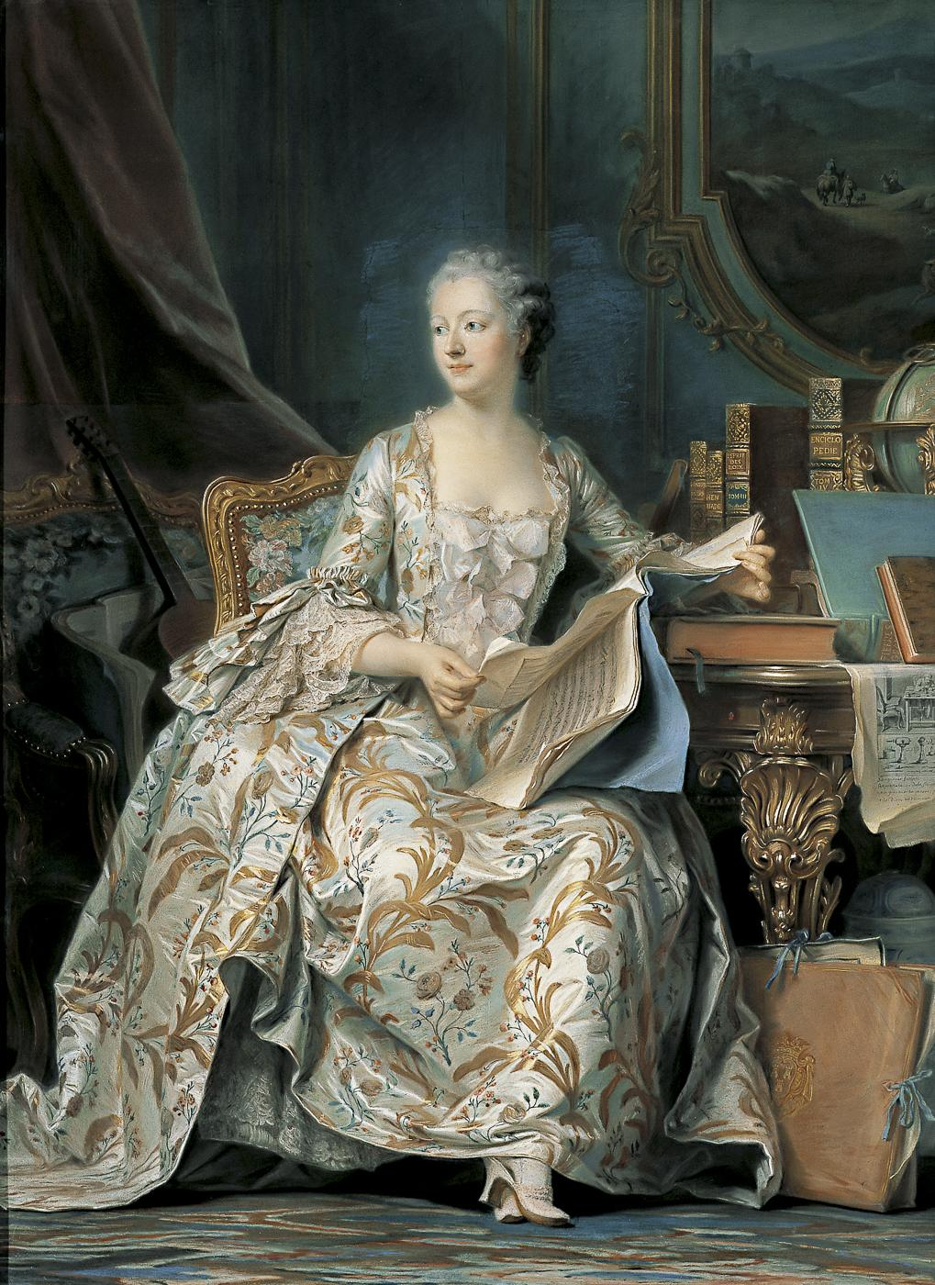
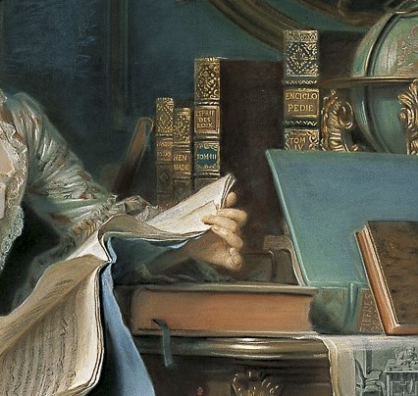
Madame de Pompadour
A bourgeois woman at the court of Louis XV.

Slide 9
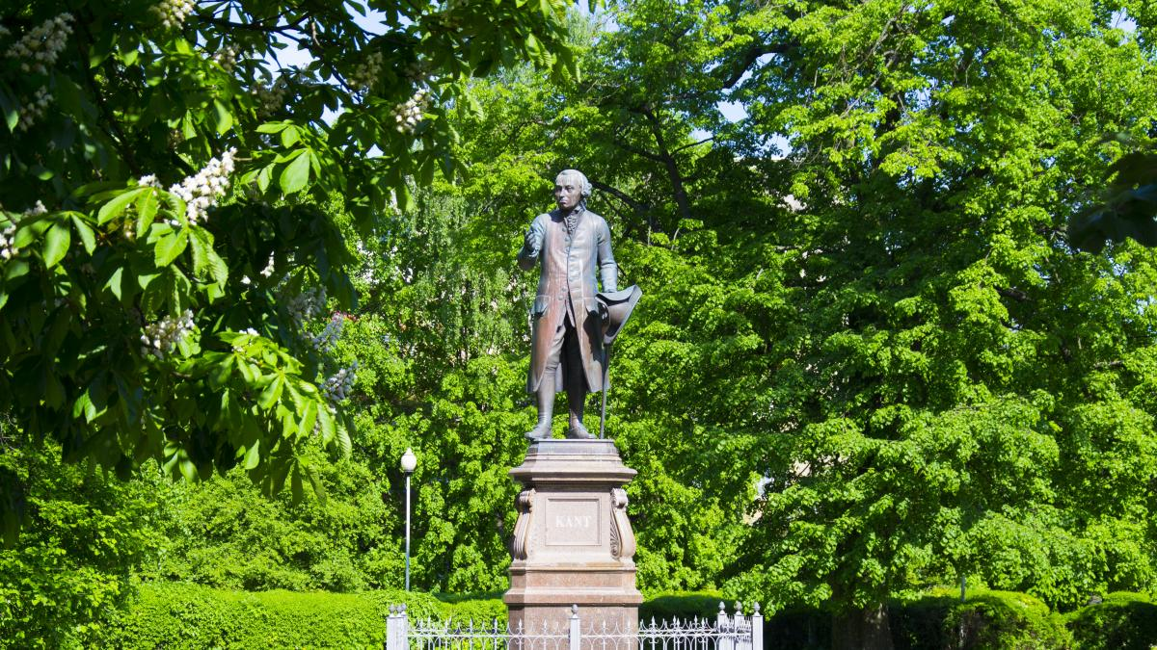
I. Kant “ Sapere aude” Dare to know

Slide 10
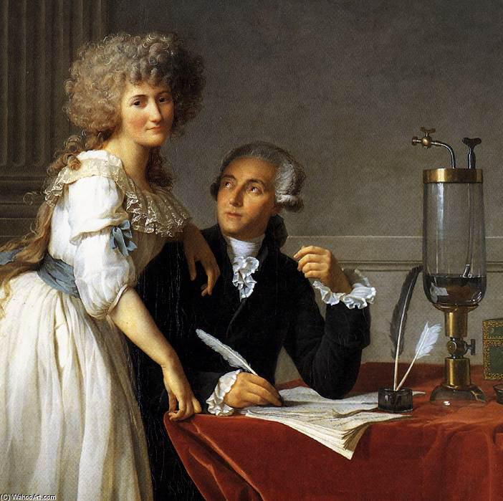
Antoine and Marie Anne Lavoisier
Founders of modern chemistry.
Portrait of Jean Louis David, MET, New York.

Slide 11
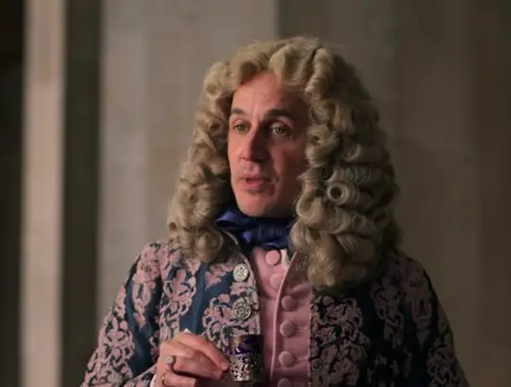
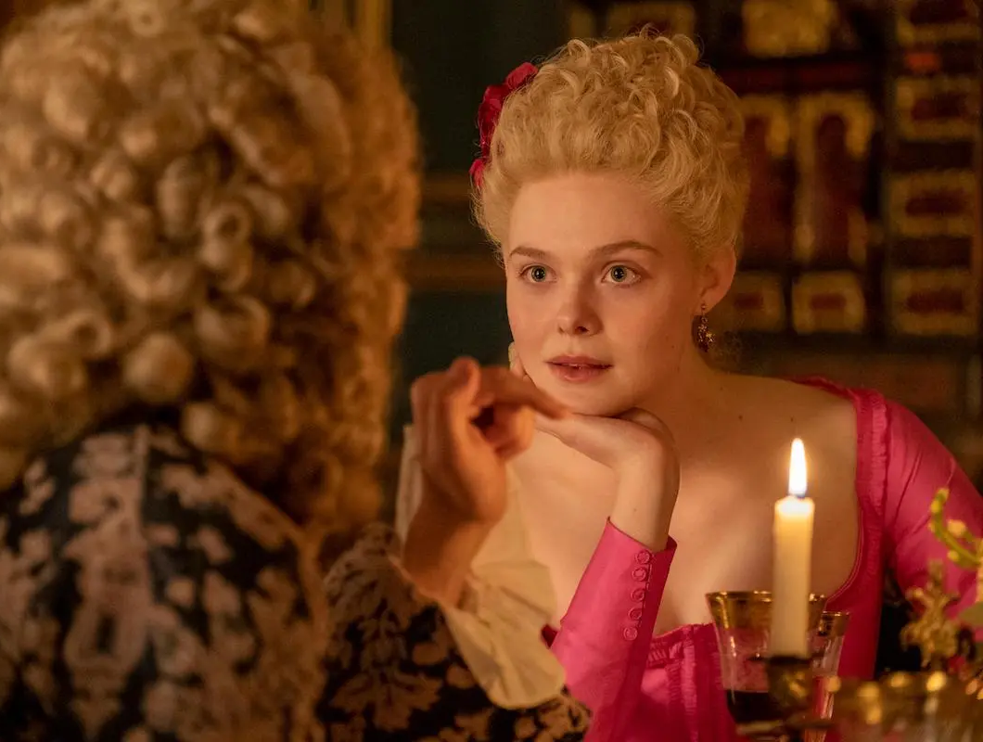
Voltaire, model of an enlightened philosopher.

Slide 12
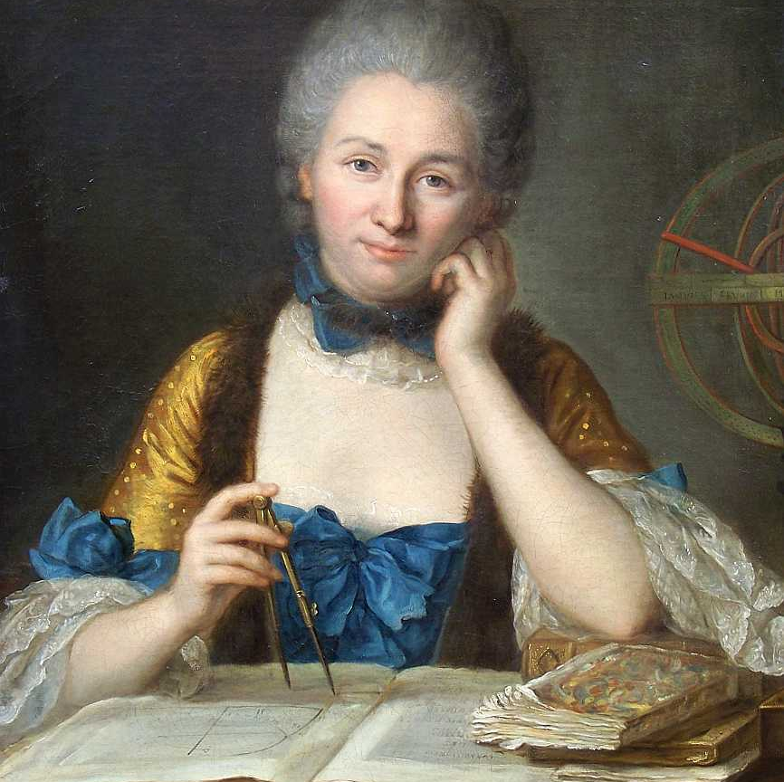
Émilie de Breteuil, Marquise du Châtelet, Enlightenment scientist
Other women of the Enlightenment were Angelika Kauffmann, Rosalba Carreira and Marianne von Martínez.

